Slide 1
A Collaboration Between ResourceX & Results for America
ICLEI USA & ResourceX
Budgeting for Resilient Action Cohort
in Partnership with the East Central Florida Regional Resilience Collaborative
Program Data
Analysis Initiative
Integrating Local Government
Budgeting and Procurement
to Advance Resilience Outcomes
Notes:
Duration: 1 minute
Say: When you begin with a program instead of a line item, the impact of the request is at the program level and tied to the organization's results. It allows departments to declare intent and add narrative; then, it gives decision-makers the ability to observe the big picture.
Lets try and bring home the concepts and examples we reviewed today……

Slide 2
The Ambition Gap
From Intent to Implementation in Local Climate Action
Too many local governments feel stymied by an “analysis and planning cycle”
An identified gap is the need for better coordination and awareness of climate activities with budget and purchasing processes.
Prepare municipalities to better use their financial capabilities to address climate change.
Leveraging existing resources through municipal and county budgets
Align resources, staffing, and priorities across departments

Slide 3
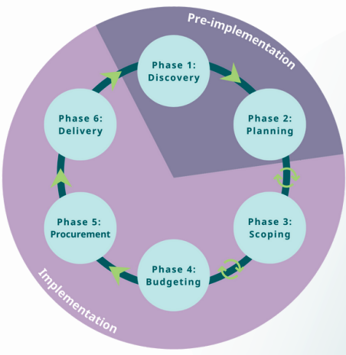
Recommendation for Local Governments
Move beyond resilience and climate planning and invest most time and resources into the implementation of resilience and climate action!

Slide 4
Six – seven 60-minute sessions
Office hours + individual support
Peer-exchange opportunities
Complete resource package
Cohort Overview
January to
June 2024

Slide 5
Roles & Expectations
Cohort Participants
Attend training sessions and review materials
Regular communication between city / county staff
Time commitment
Time commitment for city / county staff during the course of the program will vary based on:
Level of depth/detail on certain tasks
How “complete” you would like the deliverables to be
How tasks are distributed between staff
For a deliverable that includes the minimum necessary components and is nearly ready for finalization and adoption:
You need approximately 6 working months
An average of 6 hours per week

Slide 6
Cohort Deliverables
Participant Teams will:
● Identify annual budget components that have climate action implications;
● Co-develop a project that will advance an activity from a municipal climate action plan and include it as a component of the municipal budget;
● Develop a corresponding procurement execution plan or RFP solicitation designed to execute budget appropriations;
● Develop policies or procedures for enduring communication and collaboration between sustainability and climate efforts and budget and procurement exercises.
● Commit to including sustainability staff lead in the city / county budget process and procurement activity

Slide 7
Considerations & Next Steps
Ensure Commitment to Eligibility Criteria:
ECFR2C members
Cohort members will provide a team of (minimum) three members representing budget, sustainability and procurement functions.
Teams will submit a sample of up to three potential projects from their climate action plans to evaluate and workshop through the process.
Engagement in the cohort will yield a budget and procurement strategy that can be executed as part of the jurisdiction's 2024/2025 budget

Slide 8
Considerations & Next Steps
Participants will have:
Emission reduction ambition and possess a specific emission reduction target;
Climate, Resilience or Sustainability action plan and a minimum of one adopted climate policy or program
Understanding of operating programs and capital projects and demonstrated capabilities to design procurement strategies;
Teams of senior officials empowered and with authority to develop a budget, procurement and sustainability policies; and
Executive-level organizational commitment to innovation in budget, procurement and sustainability.

Slide 9
Considerations & Next Steps
Attendees and Fee Structure
Max Participants: 14 cities or counties (minimum of 8)
Fee Structure: $1,500 per city or county
To Apply: Contact Jenifer Rupert no later than October 31, 2023

